Slide 1
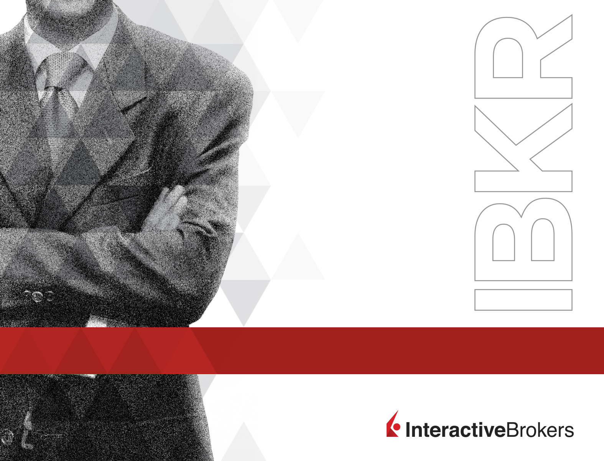
Interactive Brokers in conjunction with
Sheridan Options Mentoring present:
Dan’s 2 Strategy
Trading Plan for
2021
Dan Sheridan
Sheridan Options Mentoring
February 4, 2021
Exchange and Industry Sponsored Webinars are presented by unaffiliated third parties. Interactive Brokers LLC is not responsible for the content of these presentations. You should review the contents of each presentation and make your own judgment as to whether the content is appropriate for you. Interactive Brokers LLC does not provide recommendations or advice.
This presentation is not an advertisement or solicitation for new customers. It is intended only as an educational presentation.

Slide 2
Disclosures
Options involve risk and are not suitable for all investors. For information on the uses and risks of options, you can obtain a copy of the Options Clearing Corporation risk disclosure document titled Characteristics and Risks of Standardized Options by calling (312) 542-6901.
Futures are not suitable for all investors. The amount you may lose may be greater than your initial investment. Before trading futures, please read the CFTC Risk Disclosure. For a copy visit interactivebrokers.com.
Security futures involve a high degree of risk and are not suitable for all investors. The amount you may lose may be greater than your initial investment. Before trading security futures, please read the Security Futures Risk Disclosure Statement. For a copy visit Interactivebrokers.com.
There is a substantial risk of loss in foreign exchange trading. The settlement date of foreign exchange trades can vary due to time zone differences and bank holidays. When trading across foreign exchange markets, this may necessitate borrowing funds to settle foreign exchange trades. The interest rate on borrowed funds must be considered when computing the cost of trades across multiple markets.
The Order types available through Interactive Brokers LLC’s Trader Workstation are designed to help you limit your loss and/or lock in a profit. Market conditions and other factors may affect execution. In general, orders guarantee a fill or guarantee a price, but not both. In extreme market conditions, an order may either be executed at a different price than anticipated or may not be filled in the marketplace.
There is a substantial risk of loss in trading futures and options. Past performance is not indicative of future results.
Any stock, options or futures symbols displayed are for illustrative purposes only and are not intended to portray recommendations.
Interactive Brokers LLC is a member of NYSE FINRA SIPC

Slide 3


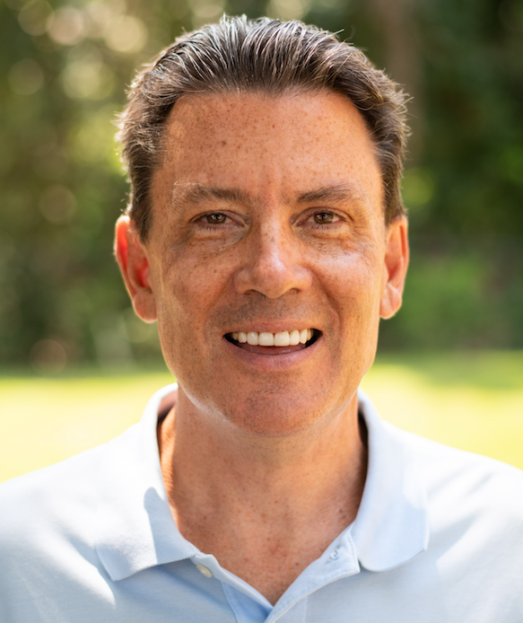
With: Dan Sheridan
“Dan’s 2 Strategy Trading Plan for 2021”
Copyright © 2021 All Rights Reserved

Slide 4

The views of speakers and their materials are their own and do not necessarily represent the views of Sheridan Options Mentoring Inc.
Options involve risk and are not suitable for all investors. Prior to buying or selling an option, a person must receive a copy of Characteristics and Risks of Standardized Options (ODD). Copies of the ODD are available from your broker, by calling 1-888-OPTIONS, or from The Options Clearing Corporation, One North Wacker Drive, Suite 500, Chicago, Illinois 60606. The information in this presentation is provided solely for general education and information purposes. Any strategies discussed, including examples using actual securities and price data, are strictly for illustrative and educational purposes. Investors should consult their tax advisor about any potential tax consequences. No statement within the presentation should be construed as a recommendation to buy or sell a security or to provide investment advice.
Multiple leg strategies involve multiple commissions charges. Brokerage firms may require customers to post higher margins than the minimum margins specified in this presentation.
The course offering can change at any time at Sheridan Options Mentoring’s discretion. Any changes to this educational program will be posted on the web site, which will serve as notification of any changes. Dan Sheridan’s classes are for educational purposes only. We are not an advisory service, nor do we guarantee any kind of return on investment. Sheridan Mentoring does not offer refunds on online class purchases.
Copyright © 2021 All Rights Reserved

Slide 5
Dan’s 2 Strategy Trading Plan
SPX 21-23 Day SPX Put Credit Spreads
SPX 15-17 Day SPX Calendar
Copyright © 2021 All Rights Reserved

Slide 6
Trading Plan
Capital?
Strategies and Allocation?
Volatility Diversification?
Price Diversification?
Yield Goals?
Size of Trades?
Copyright © 2021 All Rights Reserved

Slide 7
SPX 22 Day Put Credit Spread
P&L
+1000
0
-1000
-------------------------------
-2000
Price
3300
3400
3500
3600
3700
3800
3900
4000
4100
4200
4300
4400
3841
SPX 3841
VIX 25.39
Feb 2
Deltas 1.77
Gamma -.01
Theta 4.68
Vega -14.75
Sell 1 Feb 24 3650 Put
Buy 1 Feb 24 3630 Put
$2.50 Credit
Margin $750
Copyright © 2021 All Rights Reserved

Slide 8
SPX Put Credit Spread Guidelines
Why SPX?
Why not Stocks?
View of an Investor or a Directional Spec Trade?
Which Strikes and Duration?
Monthly Return Targets and Max Loss
Risk management?
Copyright © 2021 All Rights Reserved

Slide 9
SPX 17 Day Calendar
P&L
+2000
+1000
-------------------------------
0
-1000
Price
3300
3400
3500
3600
3700
3800
3900
4000
4100
4200
4300
3841
SPX 3841
VIX 25.37
Feb 2
Deltas .07
Gamma -.04
Theta 16
Vega 44
Buy 1 Feb 24 3840 Call
Sell 1 Feb 19 3840 Call
$9 Debit
Margin $900
Copyright © 2021 All Rights Reserved

Slide 10
Calendar Guidelines
Why SPX?
Which Strikes and Duration?
Can I trade SPY?
How do I improve/increase returns in a Calendar?
How do returns decrease in an Calendar?
4 Step Risk Management Plan for Calendars?
Copyright © 2021 All Rights Reserved

